Slide 1
H2T Electronic Store
Sketching, Low-Fi Prototyping & Pilot Usability Testing
Group 8

Slide 2
Table of contents
01
04
02
05
03
06
Introduction
Low-fi prototypes
Sketching Explorations
Testing
Discussions
Selected interface & Rationale

Slide 3
1. Introduction

Slide 4
1.
Introduction
H2T
Combination of members’ names
“Highly Higher Tech”
We don't just bring you technology; we bring you higher, better technology.
Value Proposition
We tend to highlight smarter choices and advanced tech for users’ perfect purchase.

Slide 5
Team Members
Researcher
Presenter
Analyser
Nguyen Thi Thanh Hang
Bui Hanh Trang
Nguyen Thu Huong
Mercury is the smallest planet in the Solar System
Earth is the third planet from the Sun and it harbors life
It’s the biggest planet in the entire Solar System

Slide 6
1.1
Target users
Students
Office Workers
Offer gadgets tailored to their fields of study: providing a powerful laptop for programming, a tablet for original design or tools for efficient research,…
They often need reliable and advanced tech devices to increase productivity and improve work efficiency—and they want to stay connected in their busy lives.
and more…

Slide 7
1.2.
Problems
We are addressing the challenge of choosing the right electronic devices for your needs.​
- The overwhelming variety of options can be confusing; meanwhile features budgets and personal preferences must be balanced.​
- We objective to simplify this decision-making process by using a clever chatbot that gives personalized advice and makes technology shopping easy, informed and enjoyable.​

Slide 8
1.3.
Solutions
We recognize that within our audience, there is a wide variety of preferences and levels of technological knowledge.
- Some users want quick and simple suggestions, while others prefer in-depth advice tailored to specific needs.
- Our chatbot aim to simplify electronics selection for all users, offering:
+ Personalized recommendations based on preferences, budget, and lifestyle.
+ Suggestions for work, gaming, studying, or entertainment.
+ Consultations for quick advice or detailed comparisons.
+ Community reviews and expert insights.
+ Wishlist and alerts for price drops or new arrivals.

Slide 9
02
Sketching Explorations

Slide 10
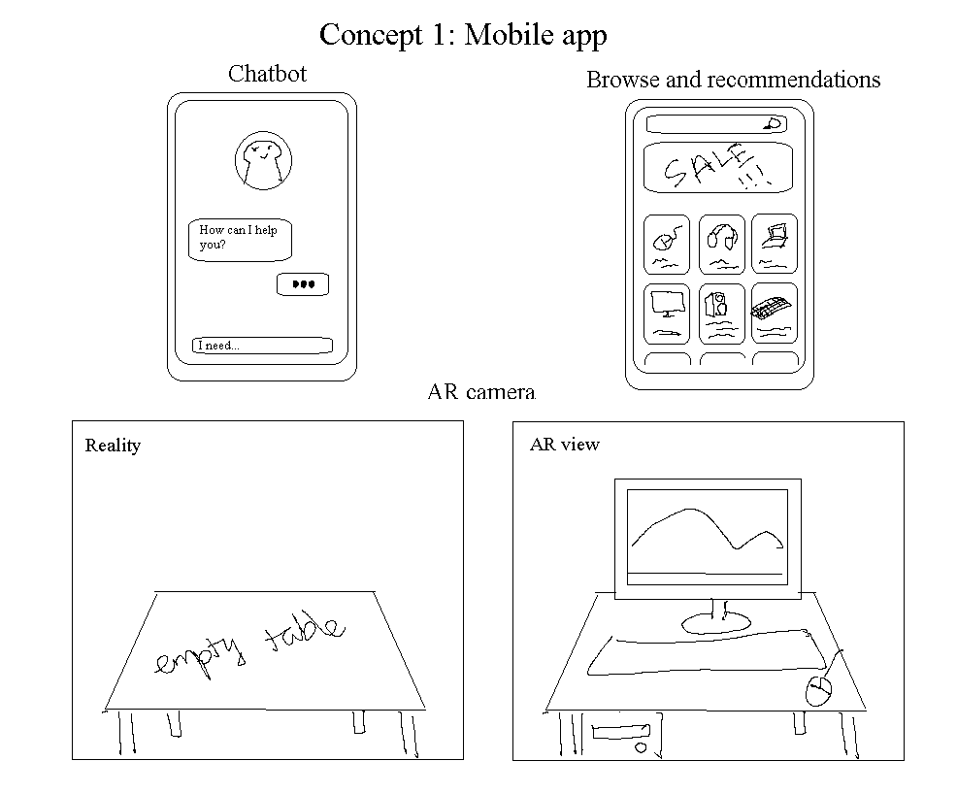
2.1. Mobile App

Slide 11
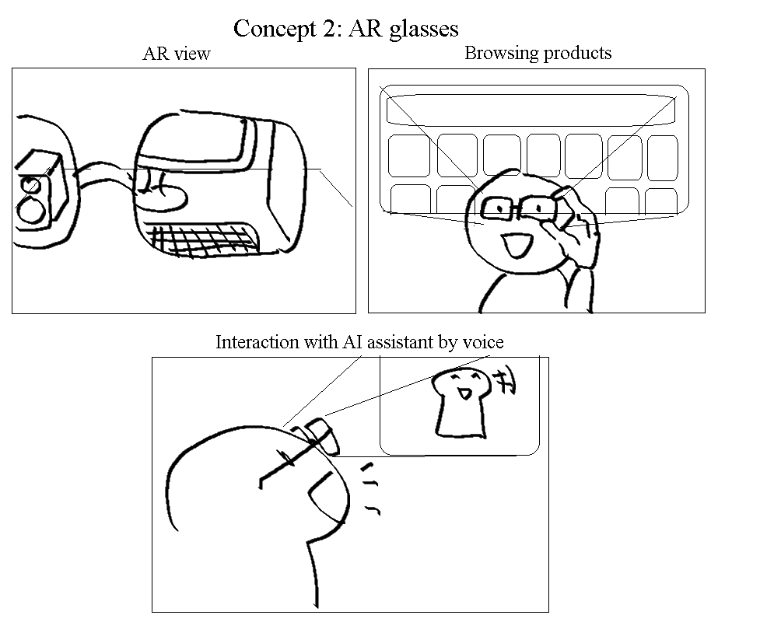
2.2. Smart/AR Glasses

Slide 12
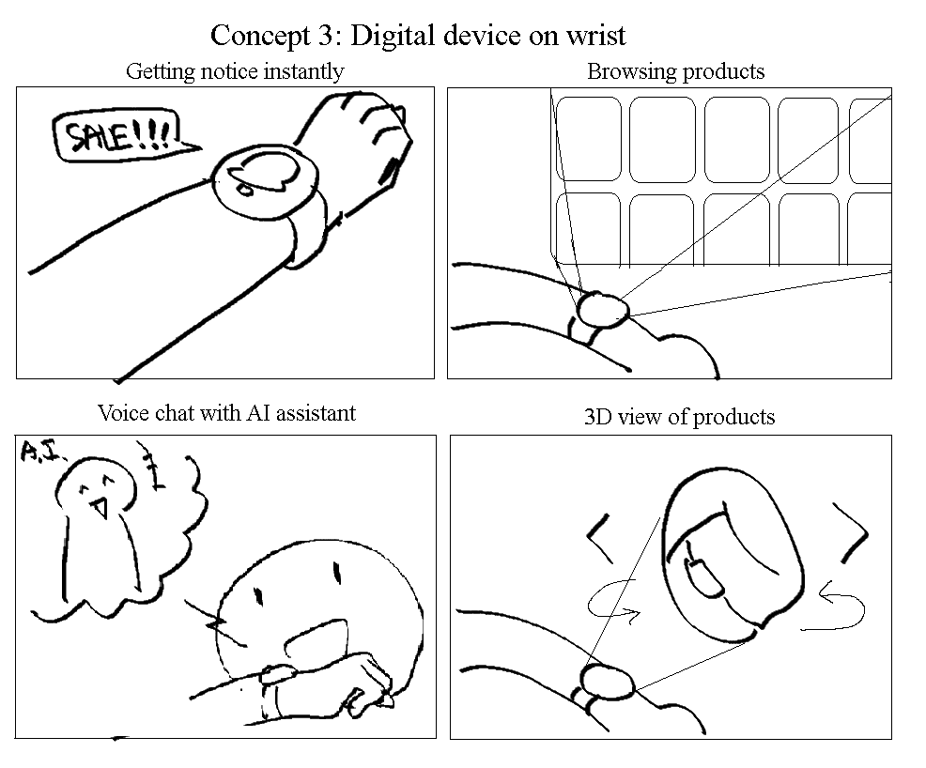
2.3. Smart Watch

Slide 13
03
Selected interface & Rationale

Slide 14
Mobile Apps Pros/Cons
Pros
Cons
High accessibility
9/10
25%
Familiarity
9/10
Portability
Limit Immersion
50%
9/10
Cost-Effective
Distraction
8/10
25%
Battery Life
8/10
Ergonomics
Notes:
Mobile Apps
Pros
Accessibility:
Widespread adoption; most people already own a smartphone.
Easy to download and update apps via app stores.
Familiarity:
Well-established user interface paradigms.
Minimal learning curve.
Portability:
Convenient to carry and use on the go.
Works in almost any setting without specialized equipment.
Cost-Effective:
Does not require additional hardware.
Development costs are typically lower than VR apps.
Battery Life:
Phones are optimized for efficiency; longer usability without quick depletion.
Cons
Limited Immersion:
Interaction is restricted to a 2D screen.
Doesn’t provide spatial awareness or immersive experiences.
Distraction:
Multitasking can interrupt the experience (e.g., notifications).
Ergonomics:
Prolonged use can lead to hand strain or posture issues.

Slide 15
VR/Smart Glasses Pros/Cons
Pros
Cons
Immersive Experience
9/10
25%
50%
25%
Enhanced Interactivity
9/10
Hands-Free Usage
Hardware Dependency
Performance Limitations
Limited Adoptions
9/10
Innovative Applications
8/10
25%
50%
Learning Curve
Comfort and Usability
Notes:
VR/Smart Glasses
Pros
Immersive Experience:
Fully engaging; users are placed directly into the virtual environment.
Augmented reality (AR) features enhance real-world interaction.
Enhanced Interactivity:
Enables 3D, gesture-based, or voice-controlled interactions.
Provides spatial computing for more intuitive usability.
Hands-Free Usage:
Ideal for scenarios where users need both hands free (e.g., fieldwork, training).
Innovative Applications:
Better suited for fields like gaming, training simulations, or industrial applications.
AR features allow for contextual overlays (e.g., navigation, repair guides).
Cons
Hardware Dependency:
Requires owning compatible VR/smart glasses, which can be expensive.
Devices can be bulky and less portable than a phone.
Battery and Performance Limitations:
Shorter battery life than smartphones.
Processing power may not yet match that of a smartphone.
Learning Curve:
New hardware and interface styles require users to adapt.
Comfort and Usability:
Wearing glasses for long periods can be uncomfortable.
Possible motion sickness in VR environments.
Limited Adoption:
Fewer users have access to VR/smart glasses compared to mobile phones.
Smaller ecosystem of apps and developers.

Slide 16
FINAL SELECTIONS

Slide 17
04
Low-fi prototypes

Slide 18
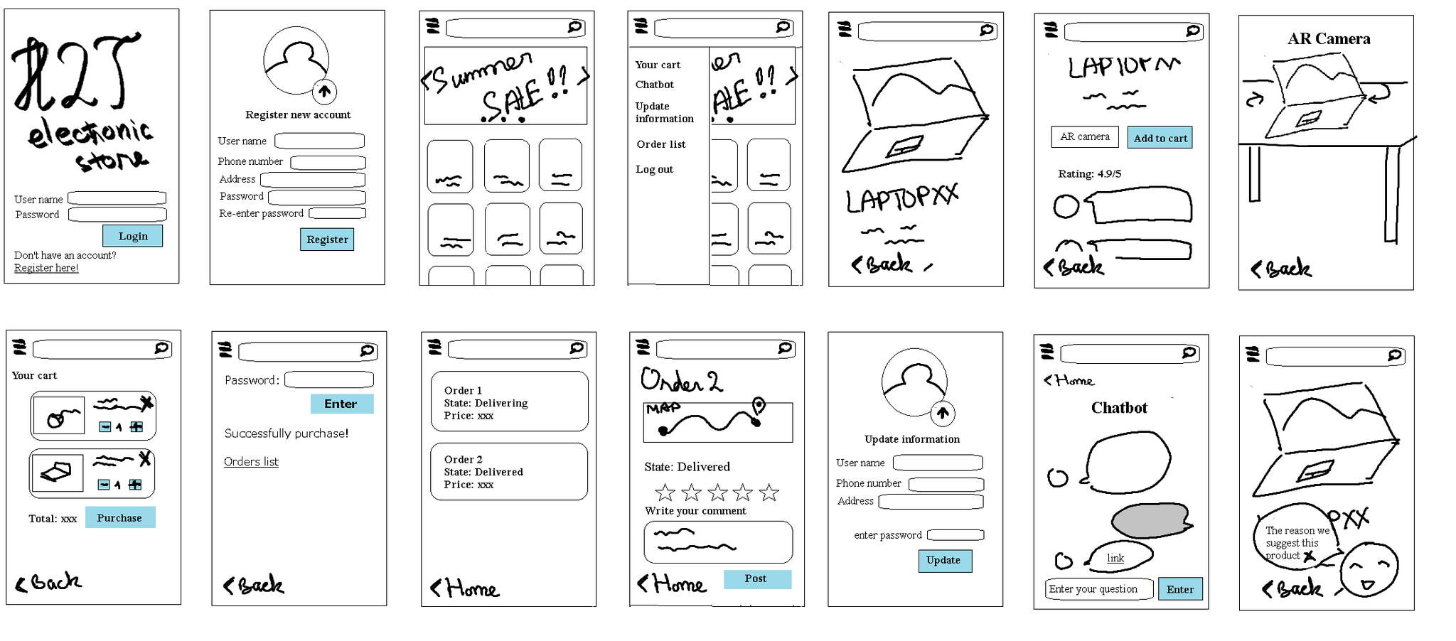
Low-Fi prototype constructions

Slide 19
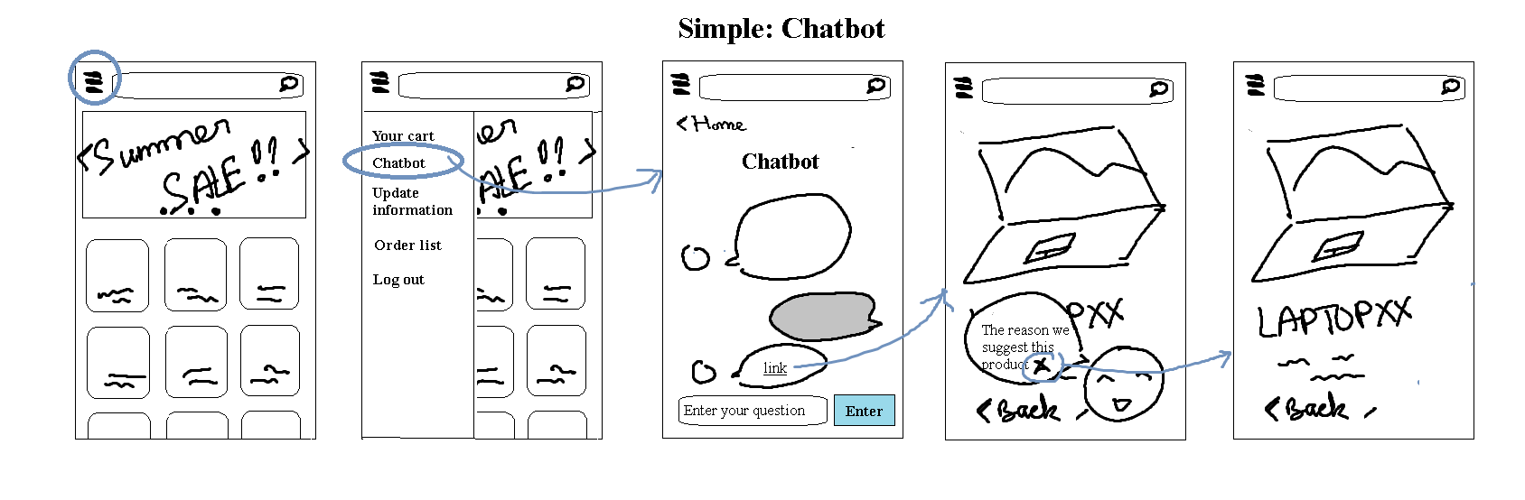
Simple: Chatbot

Slide 20
Simple: Chatbot

Slide 21
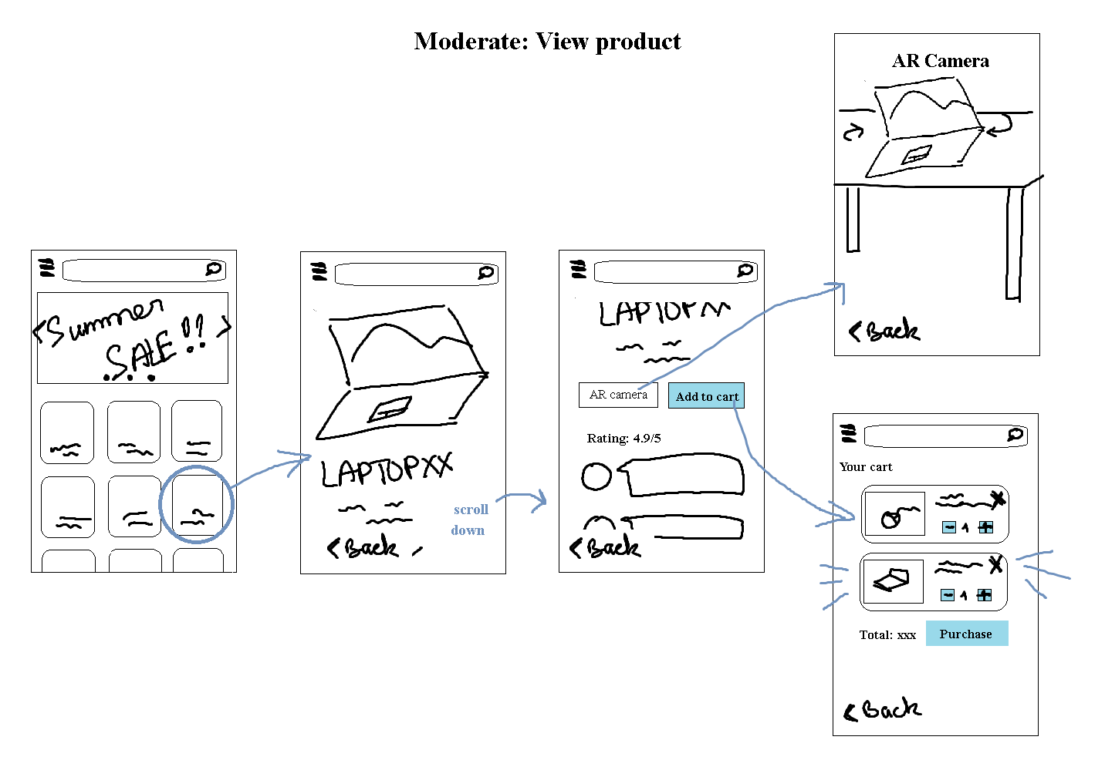
Moderate: View product

Slide 22
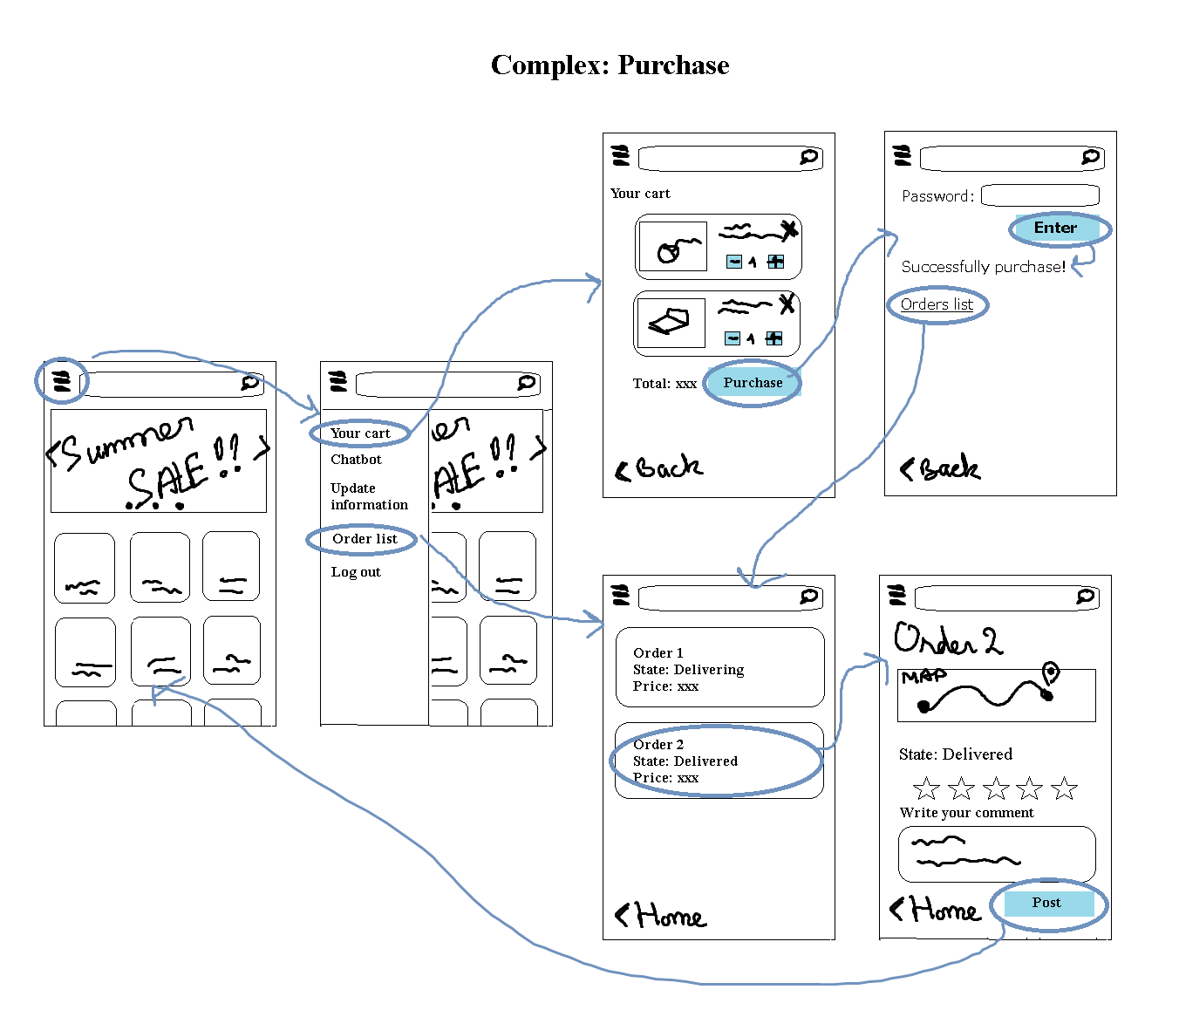
Complex: Purchase product

Slide 23
05
Testing

Slide 24
Testing Procedure
1. Provide context
Give tester the information
Explain purpose, goals & consent forms
2. Do 03 tasks
Testers is assigned 03 tasks
Process
Need to complete 03 tasks
3. Ask question
specific questions to gather thoughts
identify issues, usability concerns, or areas for improvement.
4. Ask for feedback
open-ended feedback to gain insights
opinions and suggestions for improving
5. Synthesize finding
analyzing all the feedback and observations
trends, strengths, weaknesses, and actionable recommendations
Notes:
The image outlines a Testing Procedure with five key steps. Here’s an explanation of each step:
Provide Context: This step involves giving the tester all the necessary information about the task or system being tested. It includes explaining the purpose, goals, and any relevant background to ensure they understand what they’re evaluating.
Have Tester Complete the 3 Tasks: The tester is assigned a set of three tasks (likely designed to evaluate specific aspects of the system or process). These tasks should align with the objectives of the testing and represent real-world scenarios.
Ask Questions: After completing the tasks, testers are asked specific questions to gather their thoughts, experiences, and understanding of the process or system. This step helps to identify issues, usability concerns, or areas for improvement.
Ask for Feedback: This step involves soliciting open-ended feedback from testers to gain insights that may not have been captured in the structured questions. It allows testers to share their opinions and suggestions for improving the system.
Synthesize Findings: The final step involves analyzing all the feedback and observations gathered during the test. This information is compiled to identify trends, strengths, weaknesses, and actionable recommendations for improving the process or system.
Let me know if you'd like more details or examples for any of these steps!

Slide 25
Usability Goals
Effective
Efficient
Error tolerant
Key Measurements
User reaction
Time to complete tasks
User error rate

Slide 26

Prototype Participants
Name: Dinh Trong Minh
Year: 21 years old
Doctoral student at Department of Computer Science, Dartmouth University

Slide 27
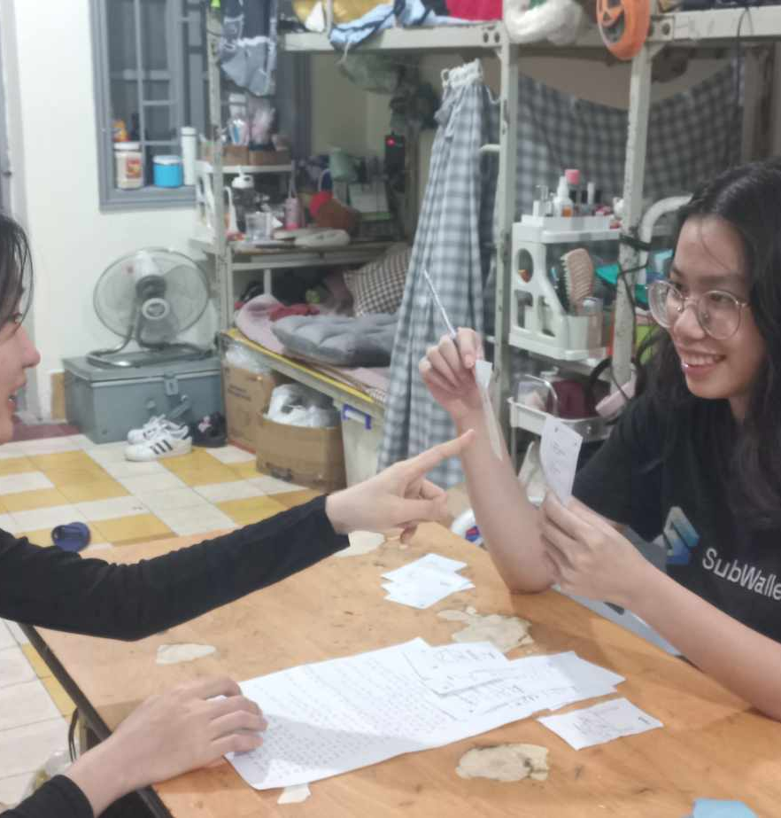
Prototype Participants
Name: Ngan Pham Hoai Phuong
Year: 22 years old
Student at FAMI Department, HUST

Slide 28

Prototype Participants
Name: Nguyen Quoc Sy
Year: 58 years old
Engineer

Slide 29

Testing results
What worked:
Concerns:
Seamless Navigation
Clear Product Details
Smooth Checkout Process
Chatbot Limitations & Privacy
Visual Clarity
Loading Speed
Key Measurement Results:
1. Response Time: average of 30s, Moderate < Simple < Complex
2. Complex tasks have a high error rate
3. The duties' thought process was well stated

Slide 30
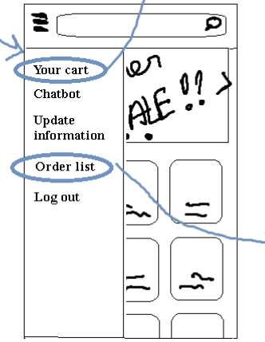
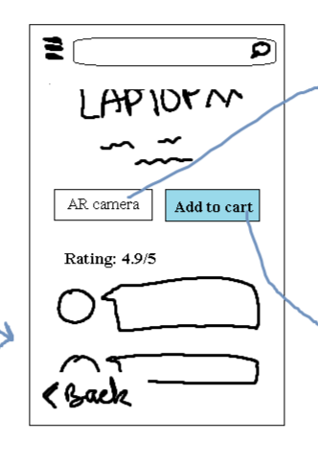
Possible UI Change
Navigation Bars
Navigation Bars
Clarify icons
Add option to sort product by category
Tutorial for AR camera
Multi languages

Slide 31
06
Disscussion

Slide 32
Guiding principles
Mercury
Venus
Mercury is the closest planet to the Sun and the smallest one in the Solar System—it’s only a bit larger than the Moon
Venus has a very beautiful name and is the second planet from the Sun. Venus is hot and has a poisonous atmosphere

Slide 33
Summary
Shortcomings of usability test:
Beautiful theme
Manual test
Only English -> hard to understand
Not have many icons, only texts
Revising usability goals:
Make experience more intuitive
Add more languages and images for the webs

Slide 34
Appendix

Slide 35
Mobile Apps Pros/Cons
Pros
Cons
1. Limited Immersion:
- Interaction is restricted to a 2D screen.
- Doesn’t provide spatial awareness or immersive experiences.
2. Distraction:
- Multitasking can interrupt the experience (e.g., notifications).
3. Ergonomics:
- Prolonged use can lead to hand strain or posture issues.
1. Accessibility:
- Widespread adoption; most people already own a smartphone.
- Easy to download and update apps via app stores.
2. Familiarity:
- Well-established user interface paradigms.
- Minimal learning curve.
3. Portability:
- Convenient to carry and use on the go.
- Works in almost any setting without specialized equipment.
4. Cost-Effective:
- Does not require additional hardware.
- Development costs are typically lower than VR apps.
5. Battery Life:
- Phones are optimized for efficiency; longer usability without quick depletion.
Notes:
Mobile Apps
Pros
Accessibility:
Widespread adoption; most people already own a smartphone.
Easy to download and update apps via app stores.
Familiarity:
Well-established user interface paradigms.
Minimal learning curve.
Portability:
Convenient to carry and use on the go.
Works in almost any setting without specialized equipment.
Cost-Effective:
Does not require additional hardware.
Development costs are typically lower than VR apps.
Battery Life:
Phones are optimized for efficiency; longer usability without quick depletion.
Cons
Limited Immersion:
Interaction is restricted to a 2D screen.
Doesn’t provide spatial awareness or immersive experiences.
Distraction:
Multitasking can interrupt the experience (e.g., notifications).
Ergonomics:
Prolonged use can lead to hand strain or posture issues.

Slide 36
VR/Smart Glasses Pros/Cons
Pros
Cons
1. Immersive Experience:
- Fully engaging; users are placed directly into the virtual environment.
- Augmented reality (AR) features enhance real-world interaction. 2. Enhanced Interactivity: - Enables 3D, gesture-based, or voice-controlled interactions. - Provides spatial computing for more intuitive usability. 3. Hands-Free Usage: - Ideal for scenarios where users need both hands free (e.g., fieldwork, training). 4. Innovative Applications: - Better suited for fields like gaming, training simulations, or industrial applications. - AR features allow for contextual overlays (e.g., navigation, repair guides).
1. Hardware Dependency: - Requires owning compatible VR/smart glasses, which can be expensive. - Devices can be bulky and less portable than a phone. 2. Battery and Performance Limitations: - Shorter battery life than smartphones. - Processing power may not yet match that of a smartphone. 3. Learning Curve: - New hardware and interface styles require users to adapt. 4. Comfort and Usability: - Wearing glasses for long periods can be uncomfortable. - Possible motion sickness in VR environments. 5. Limited Adoption: - Fewer users have access to VR/smart glasses compared to mobile phones. - Smaller ecosystem of apps and developers.
Notes:
VR/Smart Glasses
Pros
Immersive Experience:
Fully engaging; users are placed directly into the virtual environment.
Augmented reality (AR) features enhance real-world interaction.
Enhanced Interactivity:
Enables 3D, gesture-based, or voice-controlled interactions.
Provides spatial computing for more intuitive usability.
Hands-Free Usage:
Ideal for scenarios where users need both hands free (e.g., fieldwork, training).
Innovative Applications:
Better suited for fields like gaming, training simulations, or industrial applications.
AR features allow for contextual overlays (e.g., navigation, repair guides).
Cons
Hardware Dependency:
Requires owning compatible VR/smart glasses, which can be expensive.
Devices can be bulky and less portable than a phone.
Battery and Performance Limitations:
Shorter battery life than smartphones.
Processing power may not yet match that of a smartphone.
Learning Curve:
New hardware and interface styles require users to adapt.
Comfort and Usability:
Wearing glasses for long periods can be uncomfortable.
Possible motion sickness in VR environments.
Limited Adoption:
Fewer users have access to VR/smart glasses compared to mobile phones.
Smaller ecosystem of apps and developers.

Slide 37
Interview scripts
Hi! Thank you for taking the time to meet with us. Today, you will be testing our prototype for an electronic store website with a chatbox feature. You’ll walk through a series of tasks on your own, and as you do so, please share your thoughts out loud—what you’re doing, what you notice, and any concerns or ideas that come to mind. Feel free to ask questions at any point during the process.
Tasks:
1. Search and View a Product:
- Find a specific electronic product (e.g., "Wireless Earbuds").
- View its details, such as specifications and price.
2. Interact with the Chatbox:
- Use the chatbox to ask for product recommendations or assistance.
- Test a specific question, like "What’s the warranty on this product?"
3. Complete a Purchase:
- Add a product to your cart and proceed to the checkout page.
Notes:
Interview Questions (after each task): What was confusing about this task? How engaging was this task for you? Did the chatbox meet your expectations for assistance? Interview Questions (after all tasks): Overall Experience: What did you like the most and least about the website? Chatbox Feedback: How would you rate the chatbox functionality? Was there anything missing in its responses? General Feedback: Is there anything else you would like to see or not see on the website? Any additional suggestions for improvement?

Slide 38
Interview questions
1. Interview Questions (after each task):
What was confusing about this task?
How engaging was this task for you?
Did the chatbox meet your expectations for assistance?
2. Interview Questions (after all tasks):
2.1. Overall Experience:
- What did you like the most and least about the website?
2.2. Chatbox Feedback:
- How would you rate the chatbox functionality?
- Was there anything missing in its responses?
2.3. General Feedback:
- Is there anything else you would like to see or not see on the website?
- Any additional suggestions for improvement?

Slide 39
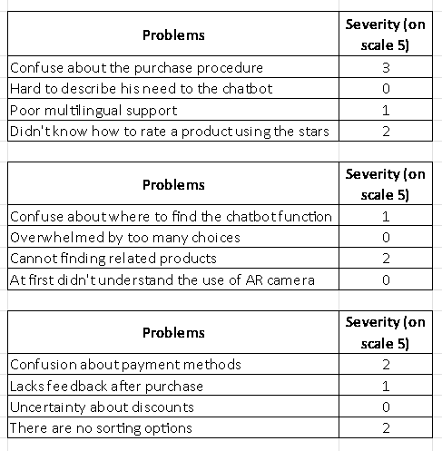
1. Dinh Trong Minh
2. Ngan Pham Hoai Phuong
3. Nguyen Quoc Sy

Slide 40
Thanks

